Slide 1

California Crimes Analysis.
Mohammad Salem

Slide 2

Table Of Contents
Data Description
Project Scope
Spatial Crime Distribution
Identify Crime-type Correlations
Crime-Type Trends by County
Conclusion

Slide 3
Data Description.

Slide 4


California Violent Crimes Dataset.
The dataset is a California‐wide repository of violent‐crime counts from 2000 through 2013. The dataset shows each city, county, year, and crime count (robbery, aggravated assault, murders, total violent crimes). The dataset included ~50,000 records of cities and years, and 27 features.
URL: https://catalog.data.gov/dataset/violent-crime-rate-9a68e

Slide 5
Project Scope.

Slide 6
1.
2.
Understand Spatial distribution of violent crime in California.
Identify crime-type correlations.
Using Choropleth Map and Marker Cluster Map for counties, and Heatmap for Cities. Analyzing, both total crimes and by crime-type.
Using a pairplot showing scatterplot of crimes. Analyze all crime correlations visually and textually.
3.
Visualize Changes in Crime-Type Over Time by County
Project Scope.
Using Time-series visualizations with scrubbing. Choose a county view changes of crimes over time.

Slide 7
1.
Spatial Crime Distribution.

Slide 8

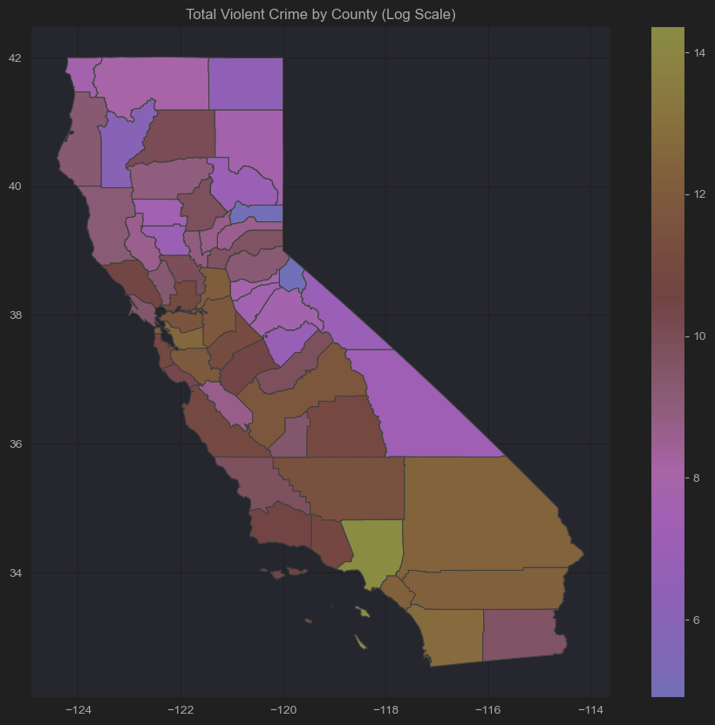
Choropleth Map
Map uses log-scale for ease of interpretation.
We conclude that Los Angeles and bay area are most dangerous in violent crime all-time.
High violence counties negatively affect surrounding counties.
Less populated areas have less all-time violent crime.
Cleaning & Wrangling Involved:
Table filtered by important columns. Pivoted to wide format, aggregated all years by county, then plotted.

Slide 9
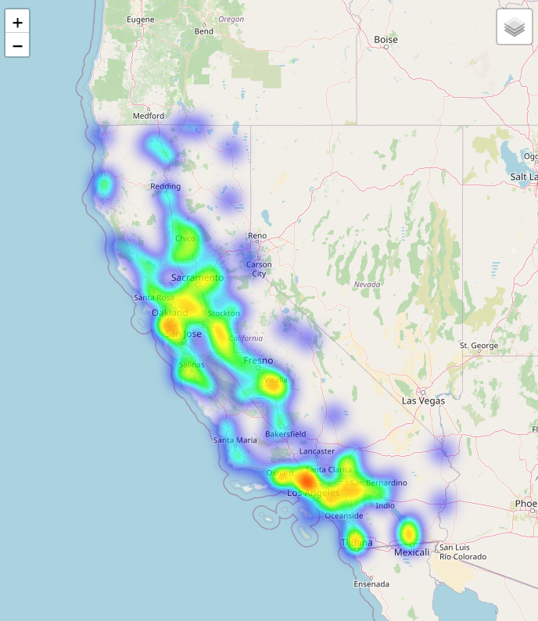
Heat Map
The heat map shows only aggravated assaults
This map reinforces the choropleth map but is more specific in the exact cities/locations influencing the county violent crimes count.
Geographical barriers like mountains can split crime spots
A considerable amount of the aggravated assaults are on or by the coast, signifying events that may be inducing these crimes.
Cleaning & Wrangling Involved:
Follows same process as choropleth, except it aggregates by city. City text had to be cleaned by replacing and stripping, etc.

Slide 10
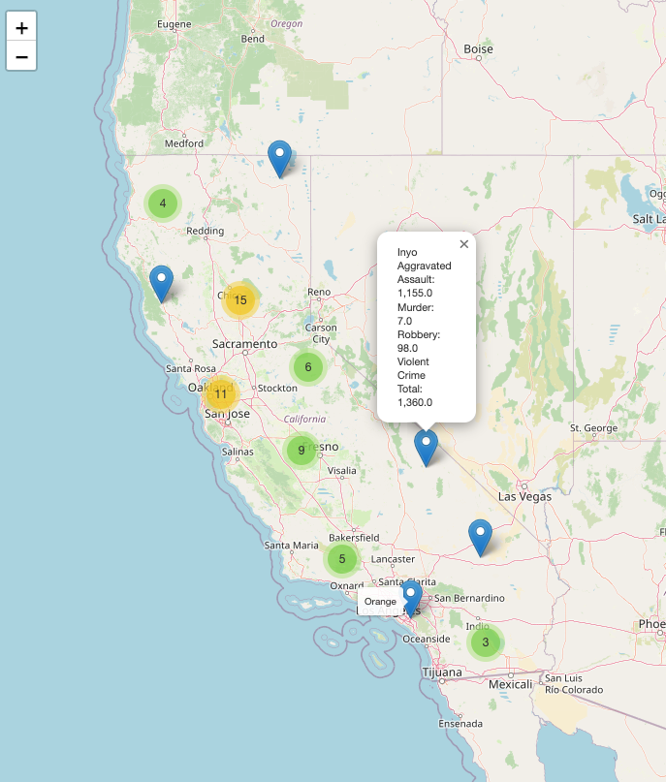
Cluster Map
The cluster map shows all counties and includes a tooltip to view the exact
This map specifies the differences of the crime types in the counties with a tooltip.
Cleaning & Wrangling Involved:
Follows same process as choropleth, extract points to use for cluster layer

Slide 11

Spatial Crime Distribution Conclusion.
Key Takeaways
Los Angeles and the Bay Area / Coastal areas are long-term violent crime hotspots.
• High-crime counties may influence surrounding areas.
• Rural counties show far lower violent crime rates.
• Coastal cities see more aggravated assaults, which can be partly due to economic inequality and geography.
• Cluster map details specific crime types across counties.
Overall, violent crime patterns are shaped by urbanization, economic divides, and geographic barriers.

Slide 12
2.
Identify Crime-type Correlations.

Slide 13
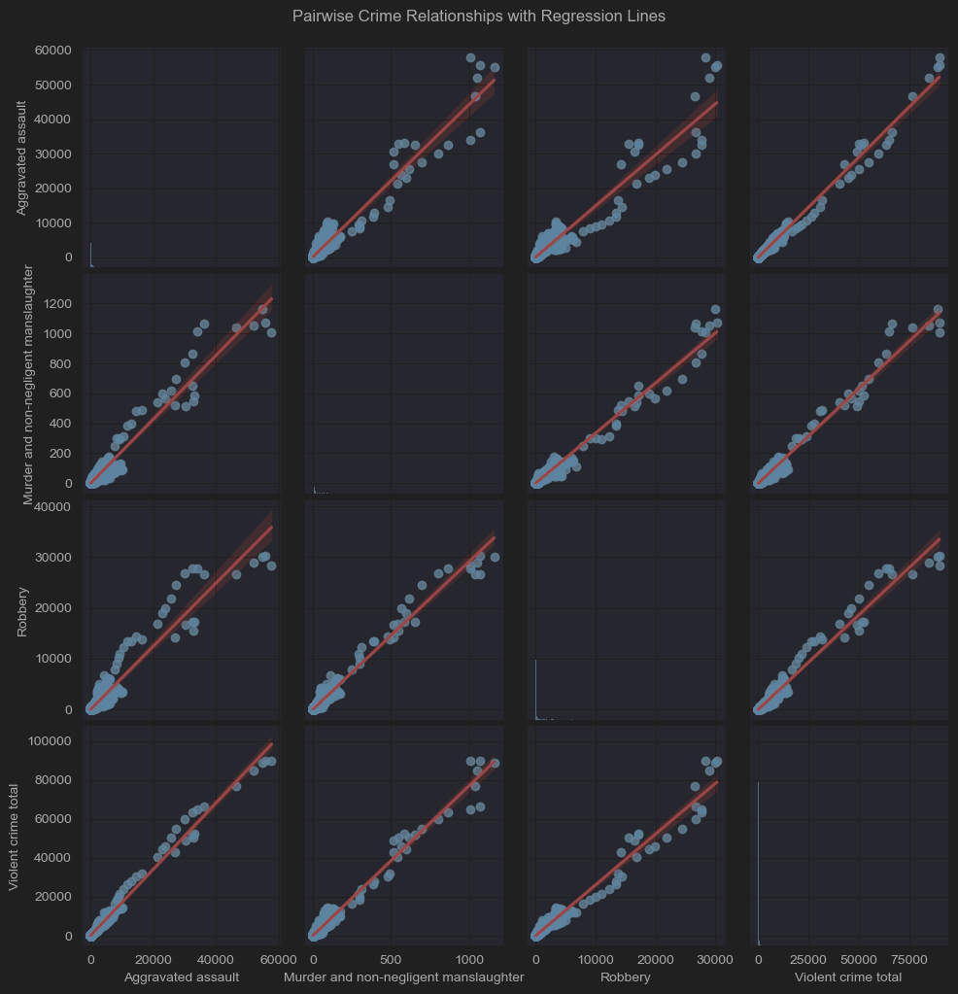
Crime-type Correlations.
Values
r = Correlation Coefficient. Measures the strength and direction of a linear relationship between two variables.
r2 = Coefficient of Determination. Tells you how much of the variance in one variable is explained by the other.
Aggravated assault vs Murder and non-negligent manslaughter: r = 0.829, r2 = 0.687
Aggravated assault vs Robbery: r = 0.883, r2 = 0.779
Aggravated assault vs Violent crime total: r = 0.987, r2 = 0.975
Murder and non-negligent manslaughter vs Robbery: r = 0.820, r2 = 0.672
Murder and non-negligent manslaughter vs Violent crime total: r = 0.851, r2 = 0.724
Robbery vs Violent crime total: r = 0.939, r2 = 0.882
Takeaways
All crime-types are positively correlated with each other
Aggravated Assault is the strongest driver of total violent crime
Murder has slightly weaker spread compared other 2 crime-types on overall violent
Murder and robbery have the weakest relationship showing that robbery doesn’t necessarily lead to or correlate strongly with murders
Most cities have low amount of crimes
Cleaning and wrangling involved:
Same cleaning and wrangling as choropleth
Used city values for each crime

Slide 14
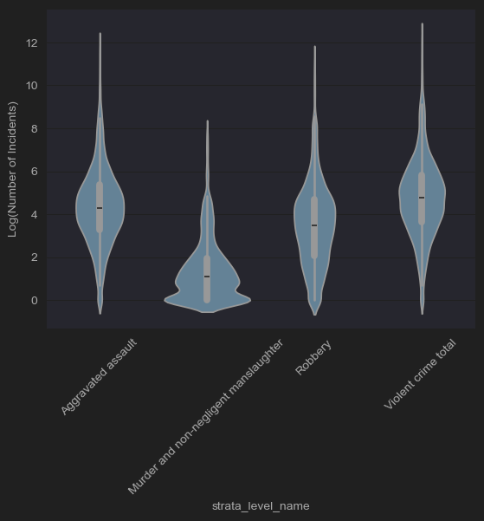
Crime-type Correlations.
Takeaways
Murders typically don’t happen often so the violin plot gets much slimmer as you go up
Aggravated assault are typically in the mid range and don’t have higher amounts on either ends
Robbery builds up, most likely due to growing population as robbery increases. This is most likely related to population so robbery would be most common in highly populated areas.
This plot reinforces that aggravated assault and total violent crimes are correlated because the two are very similar to each other
All violins have high outliers, showing that there isn’t an even distribution of crime counts and that there are concentrated hotspots, that also may affect other cities.
Cleaning and wrangling involved:
Same cleaning and wrangling as choropleth
Used log city values for each crime

Slide 15
Crime-type Correlations Conclusion.
Key Takeaways
Violent crime types are positively correlated; aggravated assault drives total violent crime.
Murder and robbery have the weakest link, suggesting different underlying causes.
Robbery rises with population size, more common in dense areas.
Most counties have low crime, but hotspots with high outliers exist.
Aggravated assault and violent crime total show very similar patterns.

Slide 16
3.
Crime-Type Trends by County.

Slide 17
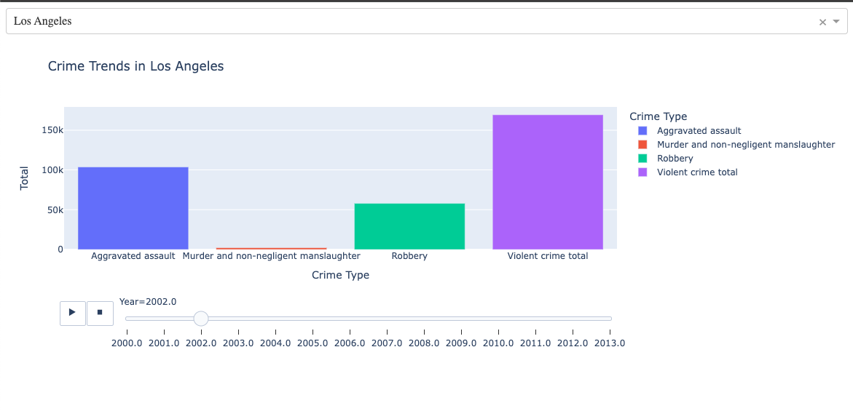
Time-series Visualization with Scrubbing
Wrangling Process:
Grouped by county, crime type, and year
Aggregates sum of city values to get county values.
Users can select a county and view crime counts by type (Aggravated Assault, Robbery, Murder, and Total Violent Crime) over time.
A year slider allows you to see how crime levels change year by year.
This visualization highlights differences in crime patterns between counties and crime types.

Slide 18
Conclusion: Understanding Violent Crime in California
Spatial distribution shows violent crime is heavily concentrated in Los Angeles, the Bay Area, and coastal cities, with rural areas experiencing far lower rates.
Crime-type correlations reveal that aggravated assault is the primary driver of total violent crime, while murder and robbery show weaker associations.
Temporary trends highlight that crime patterns differ significantly between counties, with population density and geography playing major roles.
Overall, violent crime in California is shaped by a mix of urbanization, population density, and geographic barriers.

Slide 19
End

